Slide 1
Battlecards Google Search API Experimentation
Ameya Kamat
06/23/2025

Slide 2
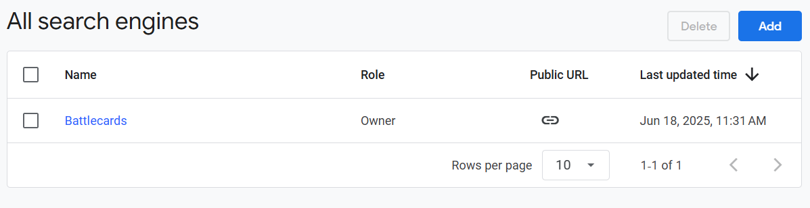
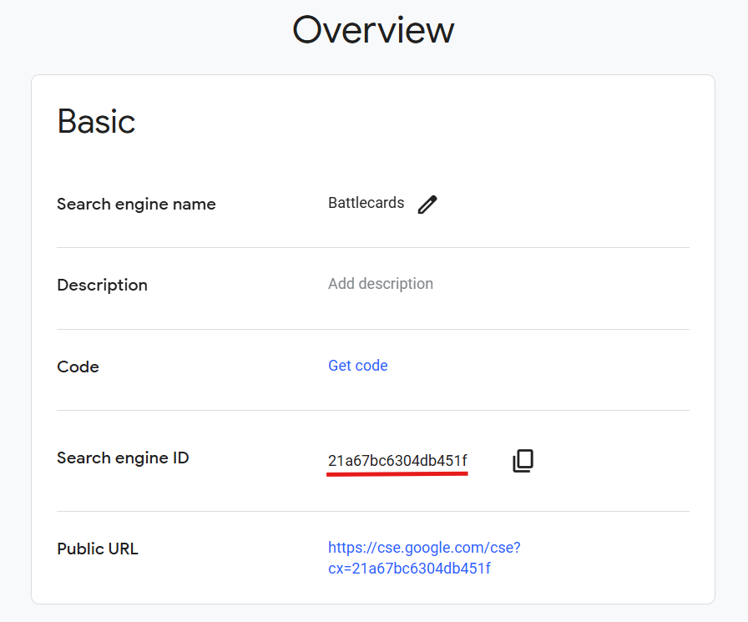
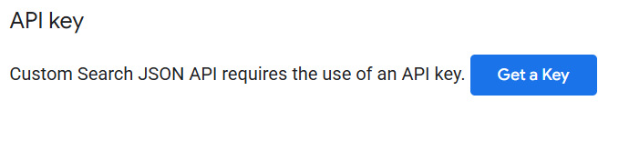
Programmable Search Engine | Custom Search JSON API
Steps to setup the search API functionality
Create a new search engine - Visit https://programmablesearchengine.google.com/controlpanel/all (Sign-in required) - Click on Add - Enter your search engine name, specific sites you wish to search OR entire web, safe search requirement, and click on create
Then, go back to the control panel (link above) and click on your newly created search engine - Search for Search engine ID under the Basic section - copy and save it
Finally, go to https://developers.google.com/custom-search/v1/overview - scroll to API key and click on Get a Key - copy and save it
Now you are ready to use the custom search API in python

Slide 3
Battlecard Generation
Search the web using the API key and custom search engine we just created to find - Leadership Changes, Mergers & Acquisitions, Recent News, and Company Overview, given a company name and its website (optional)
If provided, search the company website first
If sufficient results are not found OR company website not provided, search the entire web
Pass the search results of each section to an LLM (Groq Llama-70B) to summarize and extract the most relevant findings along with links
Finally, pass the full output to an LLM again to remove duplicates and consolidate the output
Sample battlecards generated are available here - https://github.com/kamatameya9/battlecard-generator/tree/main along with the code
Site to create a new battlecard - https://battlecard-generator-ocgysivvpnc4ju7dh9yppn.streamlit.app/
Note: The free version of the search API only allows 100 queries per day - about 5-6 companies

Slide 4
Thankyou

